Slide 1

NETWORK DESIGN PROPOSAL FOR AIRPORT
Tanya Aggarwal - RA1811003010250
Laxmi Anusri Patti - RA1811003010252
Sujoy Baitalik - RA1811003010263
Anushka Ray - RA1811003010266

Slide 2
ABSTRACT
Designed a proposal for setting up a network in an airport which has three departments, i.e., the airport authority, flight service providers and guests. The airport authority maintains a server which handles the flight management controls. The flight service providers have access only to the specific server in the airport authority and not to any other systems. The guest users have access to a high-speed internet connection which is shared among all the users in all the departments, the wireless access also uses a common password. The guest users do not have any access to the other two departments and all users of every department obtain IP addresses automatically with the help of DHCP, enabled by the server they are connected to.

Slide 3
INTRODUCTION
Airports are the most crucial and sensitive places around the world because they represent these gates through which millions of people travel each day from one place to another. With millions of people flying in and out of these places every second and thousands of people working in this industry, governments, airlines, airport authorities, and the public have become aware of the vulnerability and need to safeguard passenger and freight transportation. This intense focus has drastically changed airport operations and is straining the already tight budgets of airport authorities which made the airport authorities, along with the airlines and government to actively seek out for cost-effective technology solutions to meet the challenges. Computer networking is the most critical part of modern airports because this new technology takes the most important responsibilities, rather than people doing the tasks as in previous decades.

Slide 4
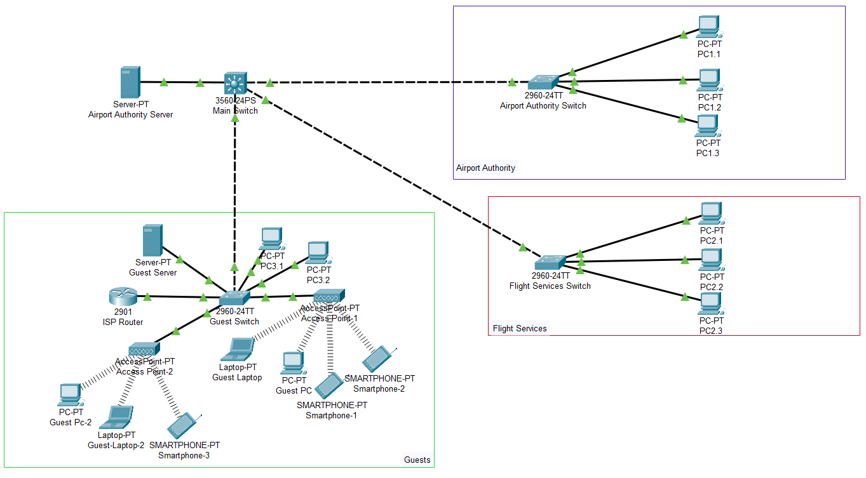

Slide 5
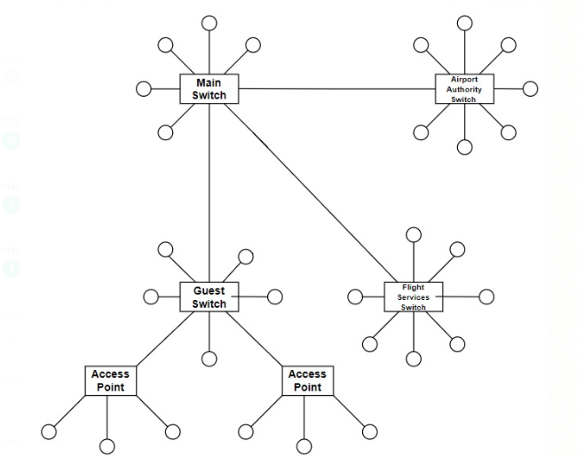
NETWORK TOPOLOGY
Hybrid Topology consisting several star topologies.
Reasons for selection -
Degree of flexibility
Increasing size of network made easy
Fault detection and troubleshooting

Slide 6
VLAN DESIGN
VLAN 2 -Set to access mode as it carries only one device , the main server and can communicate with the Airport Authorities and Flight Services.
VLAN 3 and VLAN 4 - Every device in the Airport Authority has access to each other’s data . Similarly, every device in Flight Services has access to each other’s data. But devices of Airport Authority cannot access data of devices in Flight Services but can communicate to each other and the server. Both the vlans can communicate between each other with the help of trunking.
VLAN 5 - The guest is connected to the multilayer switch using a vlan set to Trunking. Although the multilayer switch is a switch it functions like a router and helps in routing and we know that a VLAN needs to be set to trunking for it to work when connected between router and switch. The guest cannot communicate with any of the other components

Slide 7
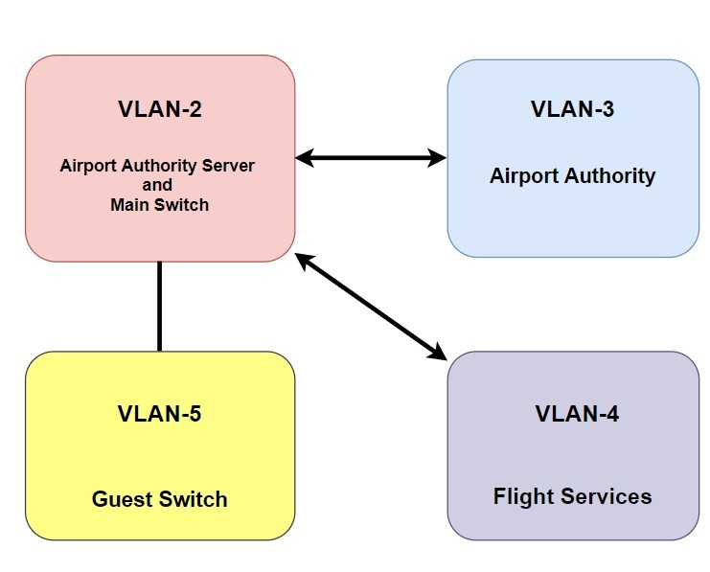

Slide 8
SERVER: SET UP
Server is configured before DHCP and VLAN is configured. Statically provide the IP, Subnet Mask, Default gateway, and the DNS server.
Enable DHCP, select the proper interface, divide the IP addresses to be used in pools.
Name each pool, provide their start IP address, Subnet Mask, DNS server and Default gateway they are supposed to allotted.
Also select the maximum no. of users that can be allotted IP dynamically in the pool. Add them to the Server.
Server is ready to dynamically allocate addresses.

Slide 9
IP DESIGN USING DHCP
Airport Authority Server - It uses DHCP to dynamically allocate IP addresses for the airport authority as well as the flight services
2. Guest Server - allocates IP addresses to the in-house devices used in the airport like monitors, screens etc using DHCP . It also allocates IP addresses to the visitor’s or guest devices such as phones or laptops dynamically

Slide 10
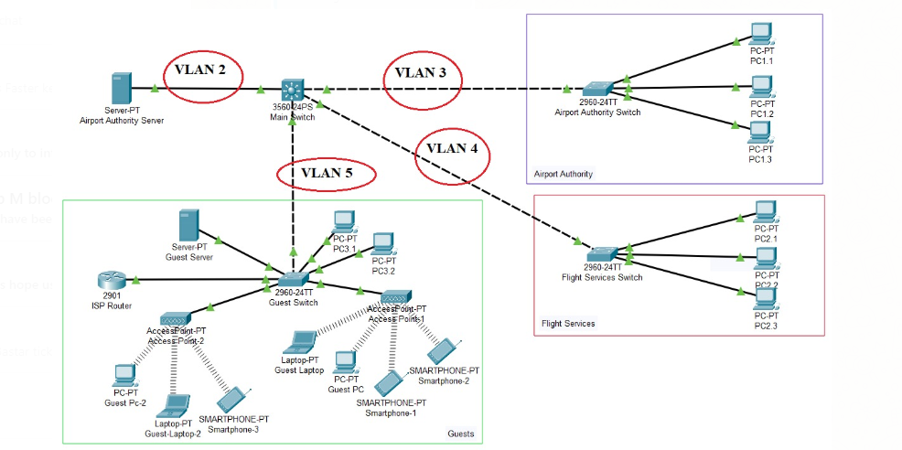

Slide 11
ALLOTTING IP ADDRESS THROUGH ACCESS POINT
In this network we have used 2 access points, but more can be connected. We can connect different access points to them to spread the Wi-Fi signal over the area.
Both are WEP encrypted and require a 10-digit password which is given to the Guests upon their arrival at Airport
Once Guests are authenticated and connected to the Access point, they obtain their IP address dynamically with the help of the DHCP enabled on the Guest server.
They have that IP address unless they disconnect, or they reach a timeout after which either they must log out or put in a new request for an IP address to the guest server.

Slide 12
MULTILAYER SWITCH
Main Switch used in our network for the airport is a multilayer switch . A multilayer switch operates at 2 different layers , the first layer for routing and the second layer for switching with incredibly fast speeds and low latency.
The multilayer switch is at the centre of this implementation. And for this reason we have implemented Access lists there.

Slide 13
ACCESS LIST
Access-list (ACL) is a set of rules defined for controlling the network traffic and reducing network attack. ACLs are used to filter traffic based on the set of rules defined for the incoming or out going of the network. The rules are followed in a sequential manner where the rules at the top are prioritized before the rules below them.
For this implementation, one of the most crucial requirements was the restriction in communication between Flight services and Airport Authority directly, as well as Guest sub-network being prohibited to communicate to any other department. This was accomplished by the use of Access List

Slide 14
HARDWARE INVENTORY LIST
1. Switches
For the Airport Authority and Flight services we will be using 2 units of same switches and for guest have used 1 unit of a different switch:
c9300 48T-48 data ports (flight services and airport authority)
c9300 48U 48 UPOE ports (Guests)
2. Multi-Layer Switch
This multilayer switch performs routing as well as switching.
c9404r -1 96 UPOE ports
3. Servers
Two servers are used, one common for both flight services and airport authority and then other in the guest department.
Dell PowerEdge mx840c with iDRAC8 (Flight services and airport authority)
Dell PowerEdge mx840c with iDRAC9 (Guests)
4. Access Points
Our model is a prototype, we have used 2 access points in the guest department. If more access points are required, then wireless controllers can be used.
AX3600 Wi-Fi 6 Dual-Band Unified Access Point
Wireless AC2600 Wave 2 Dual‑Band Unified Access Point DWL‑8620AP
5. Wireless Controller (if required)
Cisco Catalyst 9800-L Wireless Controller
6. Dell PCs (as required)
7. Ethernet Cable
CAT6A

Slide 15
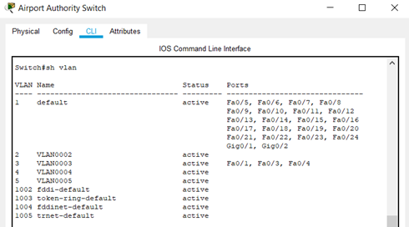
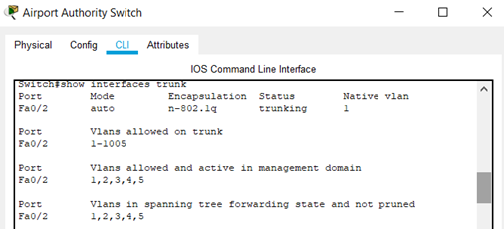
SWITCH CONFIGURATION (AIRPORT AUTHORITY)
VLAN INTERFACE
TRUNKING CONFIGURATION

Slide 16
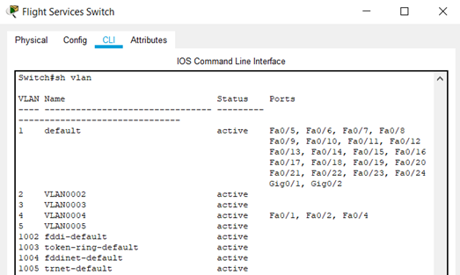
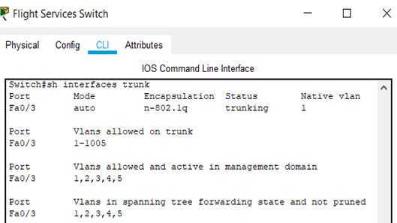
SWITCH CONFIGURATION (FLIGHT SERVICES)
VLAN INTERFACE
TRUNKING CONFIGURATION

Slide 17
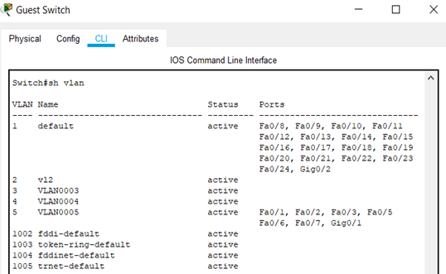
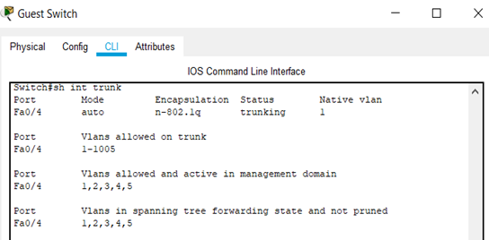
SWITCH CONFIGURATION (GUESTS)
VLAN INTERFACE
TRUNKING CONFIGURATION

Slide 18
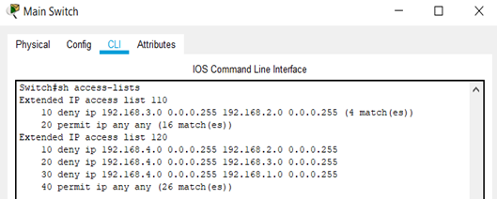
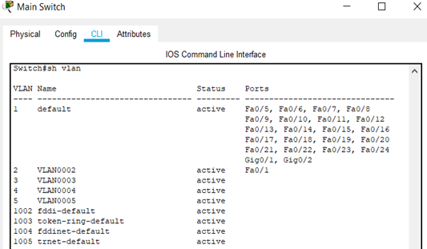
ROUTER CONFIGURATION
Instead of a router we use a multilayer switch which can act both as a switch and router.
ACCESS CONFIGURATION LIST
VLAN SUB-INTERFACES

Slide 19
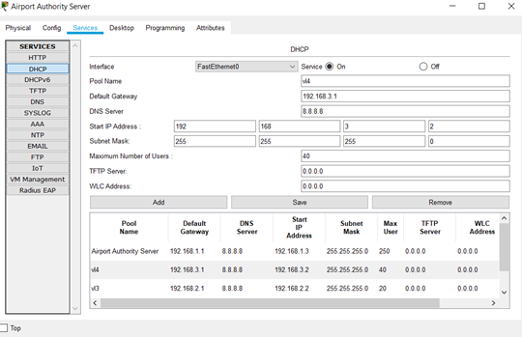
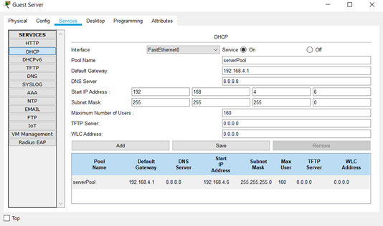
DHCP CONFIGURATION
A DHCP server dynamically assigns an IP address and other network configuration parameters to each device on a network so they can communicate efficiently with other IP networks. Here, we have used 2 servers - airport authority and guest
AIRPORT AUTHORITY SERVER
GUEST SERVER

Slide 20
CONCLUSION
Through this working prototype of the airport network infrastructure we have tried to overcome all the challenges that are there and make this industry more safe and secure. We have overcome the challenges faced in the past by implementing a streamlined end-to-end security. Our strategy was micro segmentation, that is, dividing networks into multiple micro segments and applying separate access privileges. This approach helps contain any compromise or data breach to its specific segment.

Slide 21
REFERENCES
[1] www.community.cisco.com
[2] www.packettracernetwork.com
[3] www.computernetworking747640215.wordpress.com
[4] www.tcpipguide.com
[5] www.cisco.com
[6] www.ciscopress.com
[7] www.netacad.com
[8] techgenix.com/network-topology/
[9] www.networkworld.com
[10] www.cisco.com/c/en/us/products/index.html
[11] Packet Tracer Network Simulator by Jesin A
[12] The VIRL BOOK by Jack Wang

